Slide 1
Transition Meeting
Please sign the register and complete an evaluation at the end.
Workshop facilitators
Miss Kaur– Year Group Leader
Miss Gurry – Year Group Leader
Mr Kaitell – Deputy Headteacher

Slide 2
Purpose of the meeting
To make you aware of any changes/ differences between KS1 and KS2
To give you the opportunity to ask any questions

Slide 3
New Year Three Classes for 2019-2020
Classes will be mixed as the children move into Key Stage Two.
The teachers will be:
Miss Gurry
Miss Ryan
Mrs Dias
Teaching & Learning Support Staff: Miss Betts

Slide 4
Transition
Children will have the opportunity to:
meet their new teacher on Monday 22nd July
have the chance to be in the two Key Stage Two playgrounds
be taken to locate the Key Stage Two toilets
be taken to the Upper School Hall where they will have indoor PE and assemblies
be taken into the Key Stage Two side of the Dining Hall

Slide 5
Main Differences
Timings
8:40 doors open
11:00 Break-time
12:30 Lunch
15:10 Home-time
Fruit
No free fruit provided like in KS1. You can send in fruit with your child so that they can eat it at break-time
Water Bottles
Provide your child with a water bottle that has their name on it
Homework tasks
Continue to be independent when changing their reading book
Times-Tables
x2, 5, 10, 3, 4 & 8
Lunch
No universal free school meal as it was in EYFS & KS1.
Parentpay accounts need to be credited with money for lunch unless entitled to Free School Meals.
(See next slide)
Two playgrounds to choose from at break-time and lunch-time
Collection at the end of the day in KS2 Pagoda Playground

Slide 6
School Meals
When your child joins Year 3 in September, the Government programme that entitles children in the infant phase to a free school meal each day will no longer apply.
As you are aware, this scheme was offered at no cost to all parents and I know how many appreciated the opportunity for children to enjoy cooked meals at lunchtime.
Your child may still be eligible for free school meals. If you receive any of the benefits from the list below, then they may qualify your child for free school meals.
Eligibility criteria for free school meals
• Income Support
• Income-based Jobseeker’s Allowance
• Income-related Employment and Support Allowance
• Support under Part VI of the Immigration and Asylum Act 1999
• The guaranteed element of State Pension Credit
• Child Tax Credit (provided you’re not also entitled to Working Tax Credit and have an annual gross income of no more than £16,190)
You can apply by visiting this website: https://eforms.lbbd.gov.uk/article/2046 or come into school before the end of term with your National Insurance Number and we can help you to complete the form.
You can also choose to purchase school meals. Our school catering team offer freshly prepared healthy, tasty school meals that are cooked here at Hunters Hall Primary School. You will need to pay for these using: https://www.parentpay.com
A copy of the menu will be displayed on our school website:
http://www.huntershallprimary.org.uk/school-menu/124.html A school meal will give your child a varied and balanced diet and save you time and money. Children will still be able to bring a packed lunch if you prefer. Possible packed lunch suggestions can be found here: http://www.nhs.uk/Change4Life/Pages/healthy-lunchbox-picnic.aspx

Slide 7
Times Tables
Children need to be able to recall the following:

Slide 8
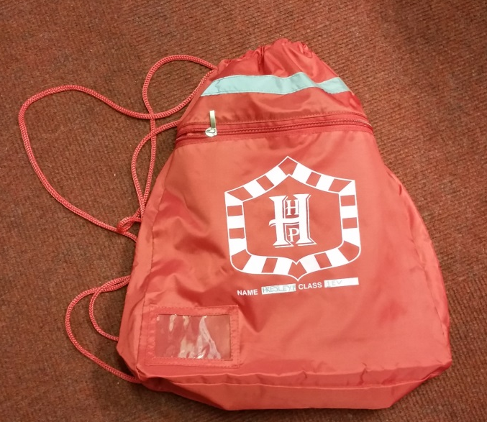
Uniform
School Uniform
Red or grey sweatshirt (with school logo)
Red or grey cardigan (with school logo)
Red or white polo shirt (with school logo)
All of the above will need to be bought from the school stockist. Parents and carers are able to buy school uniform from the dining room every Monday from 3.30 - 4.00 p.m. during term time.
Red or grey jogging bottoms (no logos or tags)
Grey trousers, skirts, pinafore dress or shorts
Red gingham dress
Red or grey jogging shorts or shadow stripe shorts
Red, grey or black tights
White or grey socks
Plain black or plain white trainers or shoes (not mules, sandals or boots)
Red or white hair accessories
P.E. Kit
Red shorts
Plain white T-shirt
Black plimsolls
During the winter months children are allowed to wear old tracksuit bottoms and a jumper in order to stay warm when taking part in PE. We cannot allow children to wear their school uniform during a PE lesson.
Please put your child’s name in all of their uniform/ belongings
https://www.schooluniformdirect.org.uk/schools/product-category/schools-and-clubs/hunters-hall-primary/?orderby=price
Book Bag
PE Kit Bag

Slide 9
HELPFUL RESOURCES YOU CAN USE AT HOME
LITERACY
Trips you could make:
Dagenham library, on the Heathway/Church Elm Lane has lots of free events: check their website for up to date details
Go to the library to explore authors you or your child may enjoy
Do some research on Ancient Egypt using non-fiction books.
At home you could
Read the library book and talk about it.
Read the reading book sent home each night with your child if possible. Ask them to tell you the story. Ask why the characters acted the way they did etc.
Practise your child’s spelling words with them each night. Look for patterns. Make it a fun activity by getting them to see how fast they can write them, or get them to sing them to you, write them with felt pens or tell their older brothers and sisters
Write a shared story together about something you have done and read it at bedtime
Practise handwriting together
Websites
http://www.woodlands-junior.kent.sch.uk/interactive/literacy.html#syn
http://www.crickweb.co.uk
http://www.tes.iboard.co.uk/player/index.htm
NUMERACY
At home you could
See how fast your child can count forwards and backwards. See if they can get to 1000, build up to it if they can’t. Count in ones, tens, hundreds.
Count in groups of 2, 5 and 10. When they know them well, ask the division questions: e.g. How many 5s are there in 45?
Write out some numbers (2,3 or 4 digit) and see if your child can order them from smallest to biggest.
Say a number and get your child to write it in words.
Ask them to give you a number with given criteria: eg a number bigger than 300 that is even; an odd number between 60 and 80 etc.
Add or subtract a one digit number or a multiple of 10/ to any two digit number. Adapt to bigger numbers if they are able.
Learn about how to double and halve a number
Apply their knowledge to solve problems using any of the four operations
Learn how to pay for things at the shop and work out how much change they should get.
Websites
http://www.woodlands-junior.kent.sch.uk/maths/
http://www.bbc.co.uk/schools/ks1bitesize/numeracy/
http://www.tes.iboard.co.uk/player/index.htm
www.mymaths.co.uk
SCIENCE
Trips you could make:
Science Museum (http://www.sciencemuseum.org.uk/)
A lot of science is about exploring and asking questions to find things out. Science is all around us!
At home you could
Collect a group of objects and make them move. Did you use a push, pull or twist?
Talk about how you made the force. Could you use a different way i.e. push with finger, blow, suck (using a straw) etc
Try and move objects on different surfaces and talk about the differences; how easy or hard it was to make the object move.
Encourage your child to ask questions and think of reasons.
Play with some magnets. What do they notice? Do they stick together (attract) or push apart (repel)?
How strong is the magnet? What can it pick up?
What is attracted to the magnet?
Explore!
Websites
http://www.crickweb.co.uk/
http://www.bbc.co.uk/schools/scienceclips/
http://www.tes.iboard.co.uk/player/index.htm

Slide 11
There are several ways for you and the school to communicate with one another. Speaking with a member of staff at the start of the day End of day collection Sending a note Parent/Carer Evenings Snippets Newsletter Reading Record/Log Curriculum Newsletter Website/ Twitter Parenthub

